Slide 1
Notes:
Teacher Notes:
Use this PowerPoint to help you deliver a LOUD assembly in your school. It will help pupils to understand what Global’s Make Some Noise does and it will spark ideas for how your school can get loud on Friday 5th October 2018 for Global’s Make Some Noise Day. By the end of the presentation, your pupils will know why they will be fundraising and hopefully they’ll feel inspired to raise lots of money to help disadvantaged young people across the UK.
This assembly presentation is designed to last 15 minutes. There are hints and tips in the notes to make it longer if you like or to make it interactive.
This presentation can be used for the whole school or in class alongside other lesson activities which can be found here: makesomenoise.musicradio.com/schools/

Slide 2
BANG!
POP!
BOOM!
SPLAT!
WHOOSH!
Notes:
Teacher Notes:
Get your pupils to shout out these words, the LOUDER the better! You can include even more noisy words to keep your pupils engaged.
Explain that they have just made lots of noise, which is what Global’s Make Some Noise does for small charities across the UK, that support children and young people living with illness, disability or lack of opportunity.

Slide 3
Why we’re helping
Notes:
Teacher notes:
Here’s a story from one of the charities that Make Some Noise supports.
If the link doesn’t work by clicking on the image, please find the video here: https://youtu.be/I476K_aFWVM
Use this video to help pupils understand who they’ll be supporting through their fundraising and how the money they raise can make a difference.
Ask your pupils – how did the video make you feel? Sad? Happy? After three, make some noise if you want to help children like these – 1, 2, 3…
(Shout) MAKE SOME NOISE

Slide 4
Listen up!
Notes:
Teacher Notes:
Explain to the students how all these radio stations come together to make lots of money to change young lives and are in need of their help.
More information about the charity:
Make Some Noise is the official charity of Global, the media and entertainment group. They support small but brilliant charities across the UK, which help young people and their families living with illness, disability or lack of opportunity.
These charities are so small that they struggle to get heard, so, every year, some of the UK’s best-loved radio stations come together with some of the biggest names in the world of music and entertainment to tell their stories and to raise as much money as possible.
Together they use the power of radio to MAKE SOME NOISE for those who struggle to be heard.

Slide 5
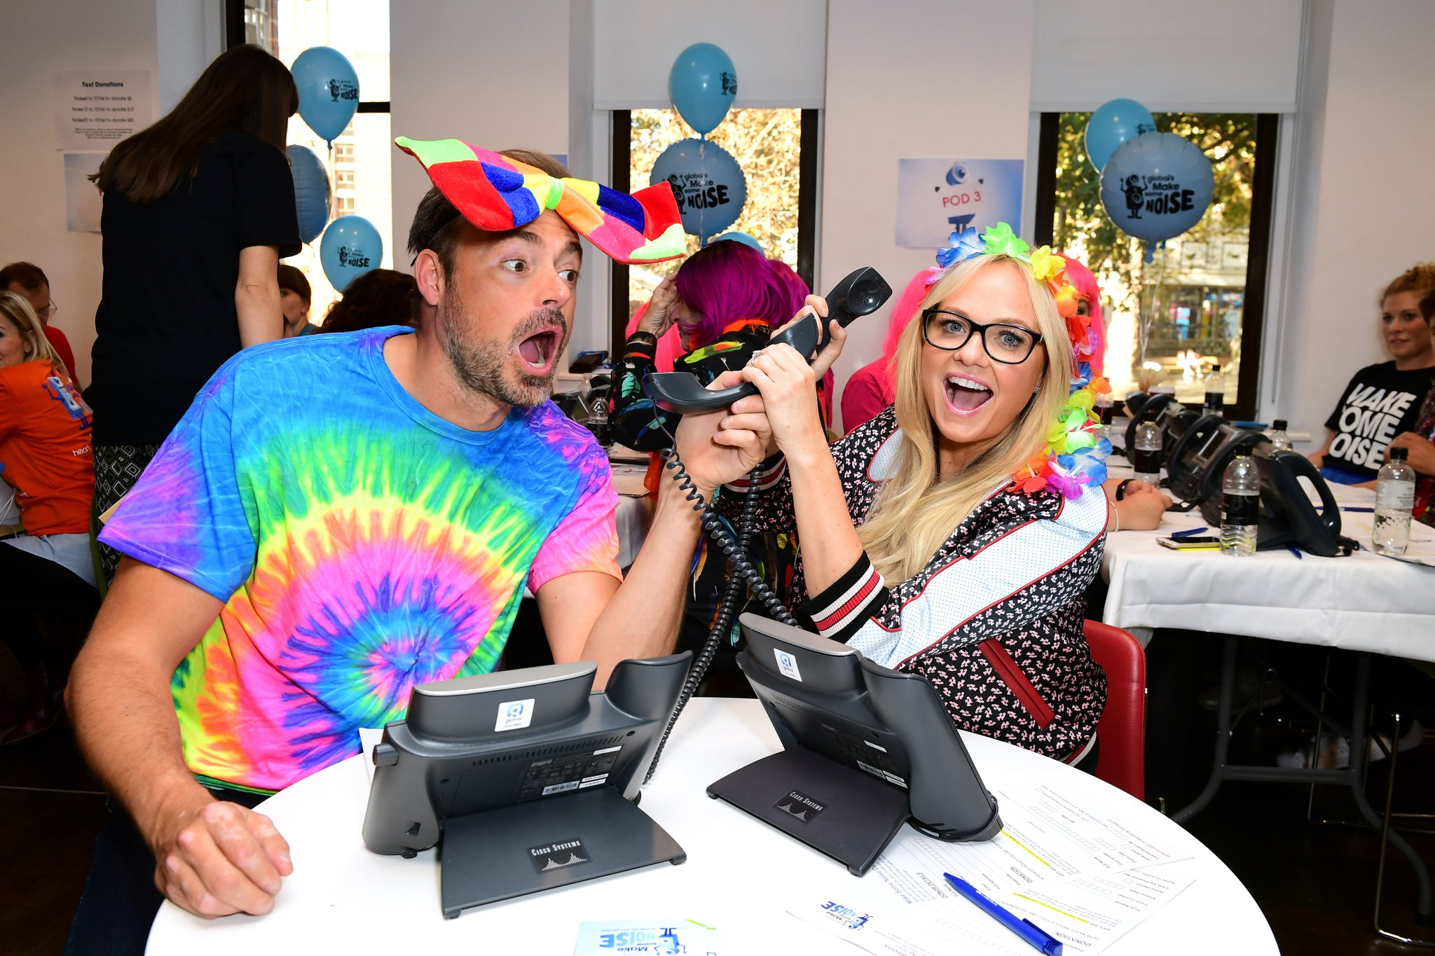
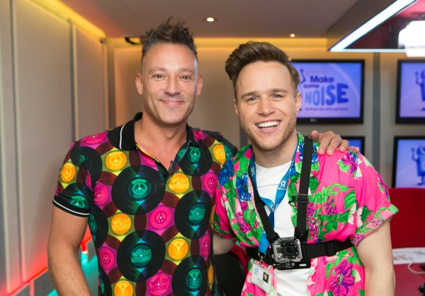
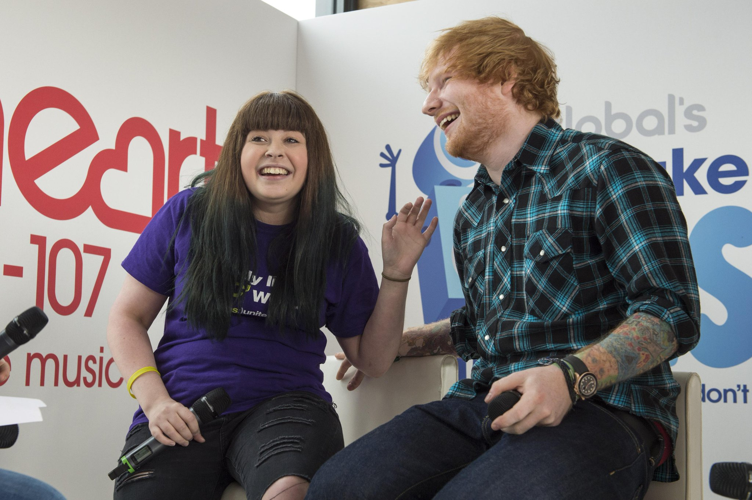
Join us!
Notes:
Teacher notes:
Ask for a show of hands – can you name these celebrities?
Or ask: Has anyone heard of Olly Murs? What about Emma Bunton? Or Ed Sheeran?
They’re just some of the famous faces who have made lots of noise for small charities in the past. They’ve done this by getting involved on Make Some Noise Day – either by dressing loud or taking on crazy challenge to raise money, or by meeting the charities to share their stories.
Answers:
Clockwise from Top left – Heart radio Breakfast presenters Jamie Theakston and Emma Bunton
Top right – Capital presenter Marvin Humes
Bottom left – Heart presenter Toby Anstis and pop star Olly Murs
Bottom right– Ed Sheeran with a surprised fan from one of charities

Slide 6
What shall we do?
Notes:
Teacher notes:
Meet Noisy. He’s the official mascot of Global’s Make Some Noise.
There are so many fun things that we can do in this school to join in and help. What shall we do? I want you all to clap and cheer for your favourite idea and we’ll mark how loud you were out of ten to find out which was your favourite:
We could all dress LOUD and put on our whackiest, most colourful clothes for the day - clap if you think that’s a good idea.
We could hold a special LOUD event like a talent show or a school disco - clap if you think that’s a good idea.
We could Bake Some Noise and have a bake sale or sell delicious biscuits – clap if you think that’s a good idea.
We could get sponsored by friends, family and local companies to do a big challenge – it could be a sponsored silence, a themed movie night, a Zumba competition. Clap if you think any of these are good ideas.
Ask for any ideas – what would your pupils like to do?

Slide 7
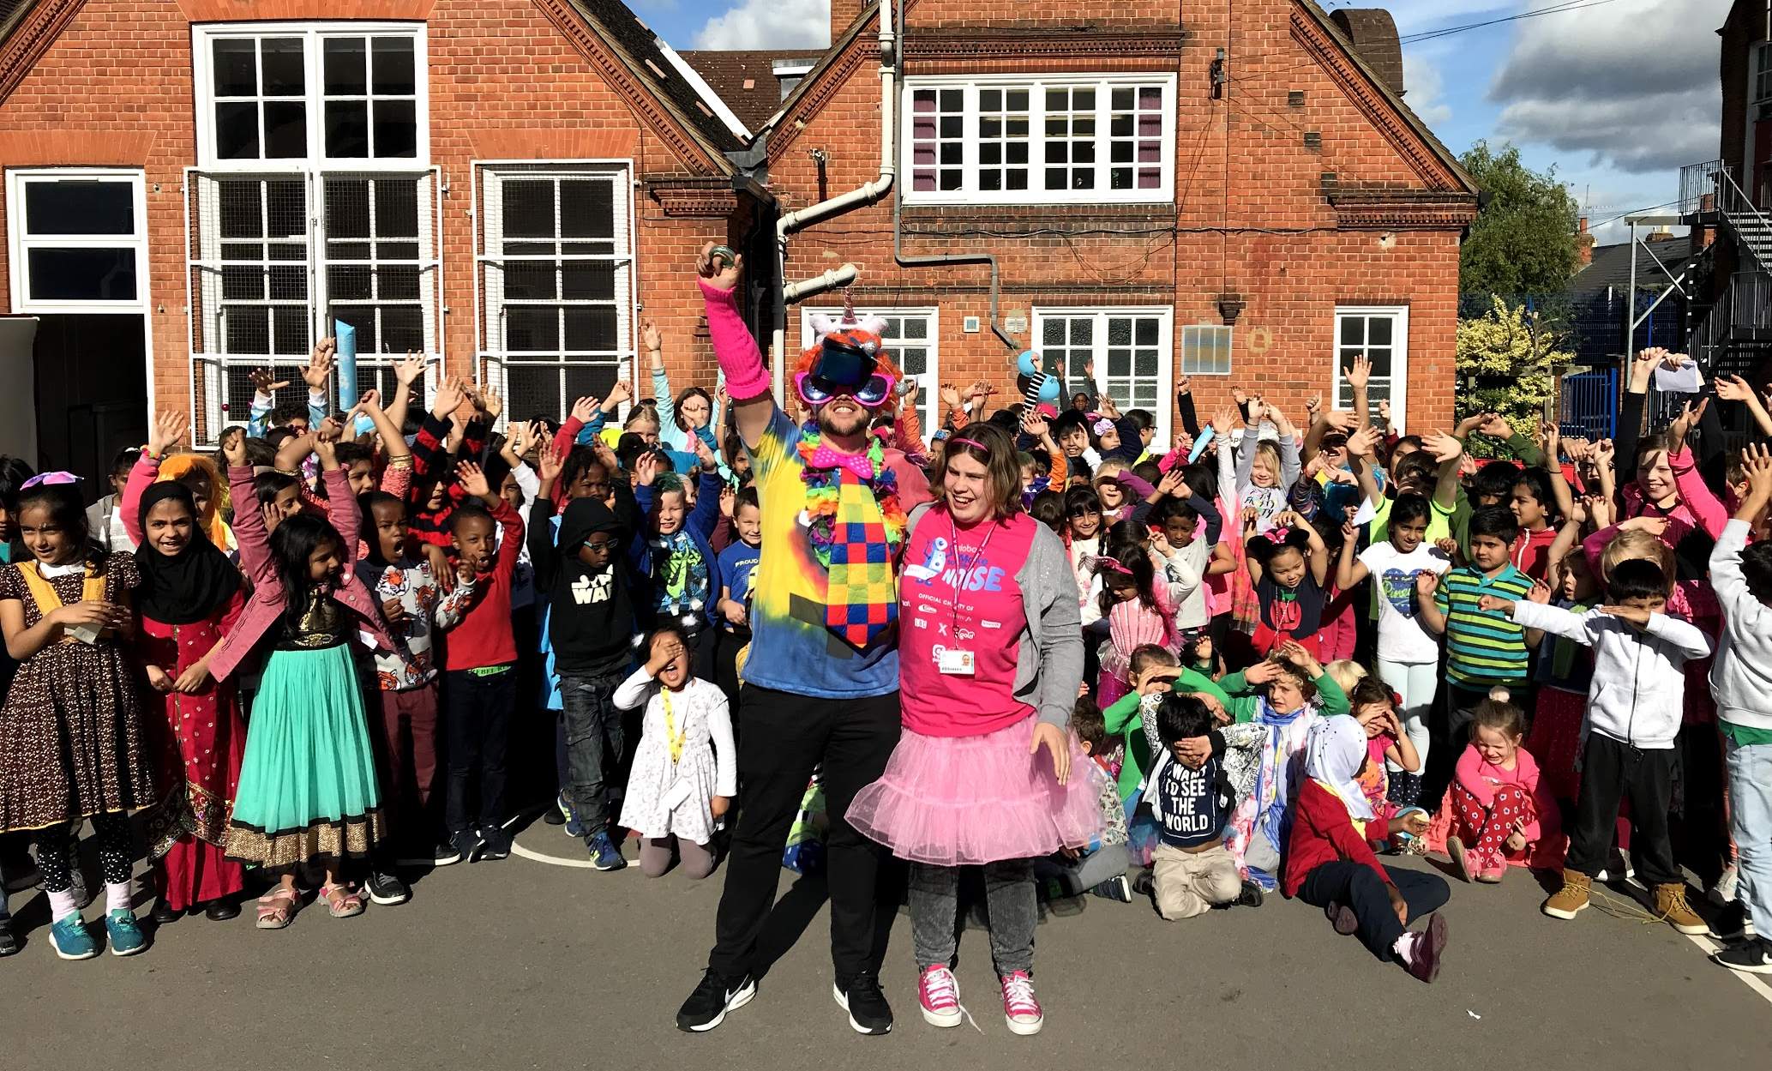
Get involved
Notes:
Teacher notes:
Lots of schools up and down the country will be getting involved.
There’s a chance for us to win some great prizes - including music equipment for our school or a visit from our local radio station.

Slide 8
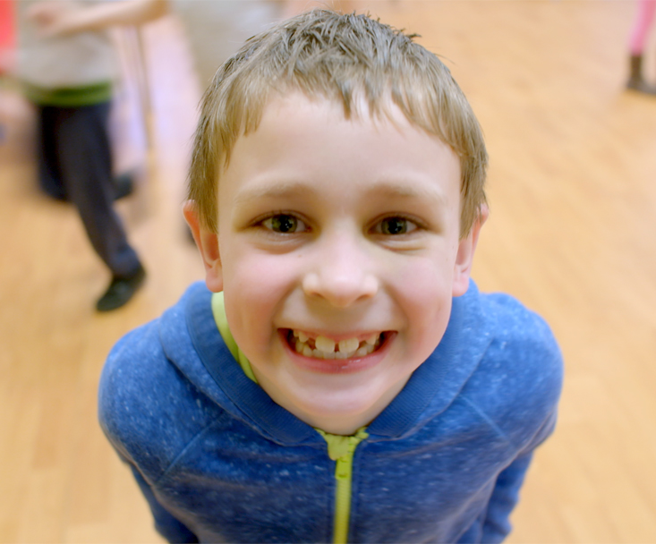
How your money helps
Notes:
Teacher notes:
Life can be tough for a child or young person living with an illness, disability or lack of opportunity. It can be very isolating for them and their family.
By taking part in Make Some Noise Day on 5th October, we’ll be raising money to improve the lives of children and their families all over the UK.
We make a difference by funding vital equipment and frontline services to help children and young people through tough times, including therapy, counselling, nursing and support groups.
INTERACTIVE QUESTION: Do you know how many pupils we have in this school? If you each raise £1 do you know how much money we would raise?

Slide 9
Save the date!
MAKE SOME
NOISE DAY
5TH OCTOBER
Notes:
Teacher notes:
Remember the date - Make Some Noise Day is on Friday 5th October.
We’re all going to join in with this special day – parents, pupils and teachers. We’ll have some fun and also help these small charities.
[End of presentation]
Now that your pupils have picked how they want to fundraise for Make Some Noise, check out the fundraising pack for the next steps.
Make sure you head to the WIN section on the website to tell us what you’re doing on 5th October and your school could be in with a chance of winning a Yamaha Clavinova piano so your school can keep making lots of noise.
THANK YOU!

